Slide 1


Slide 2


Slide 3
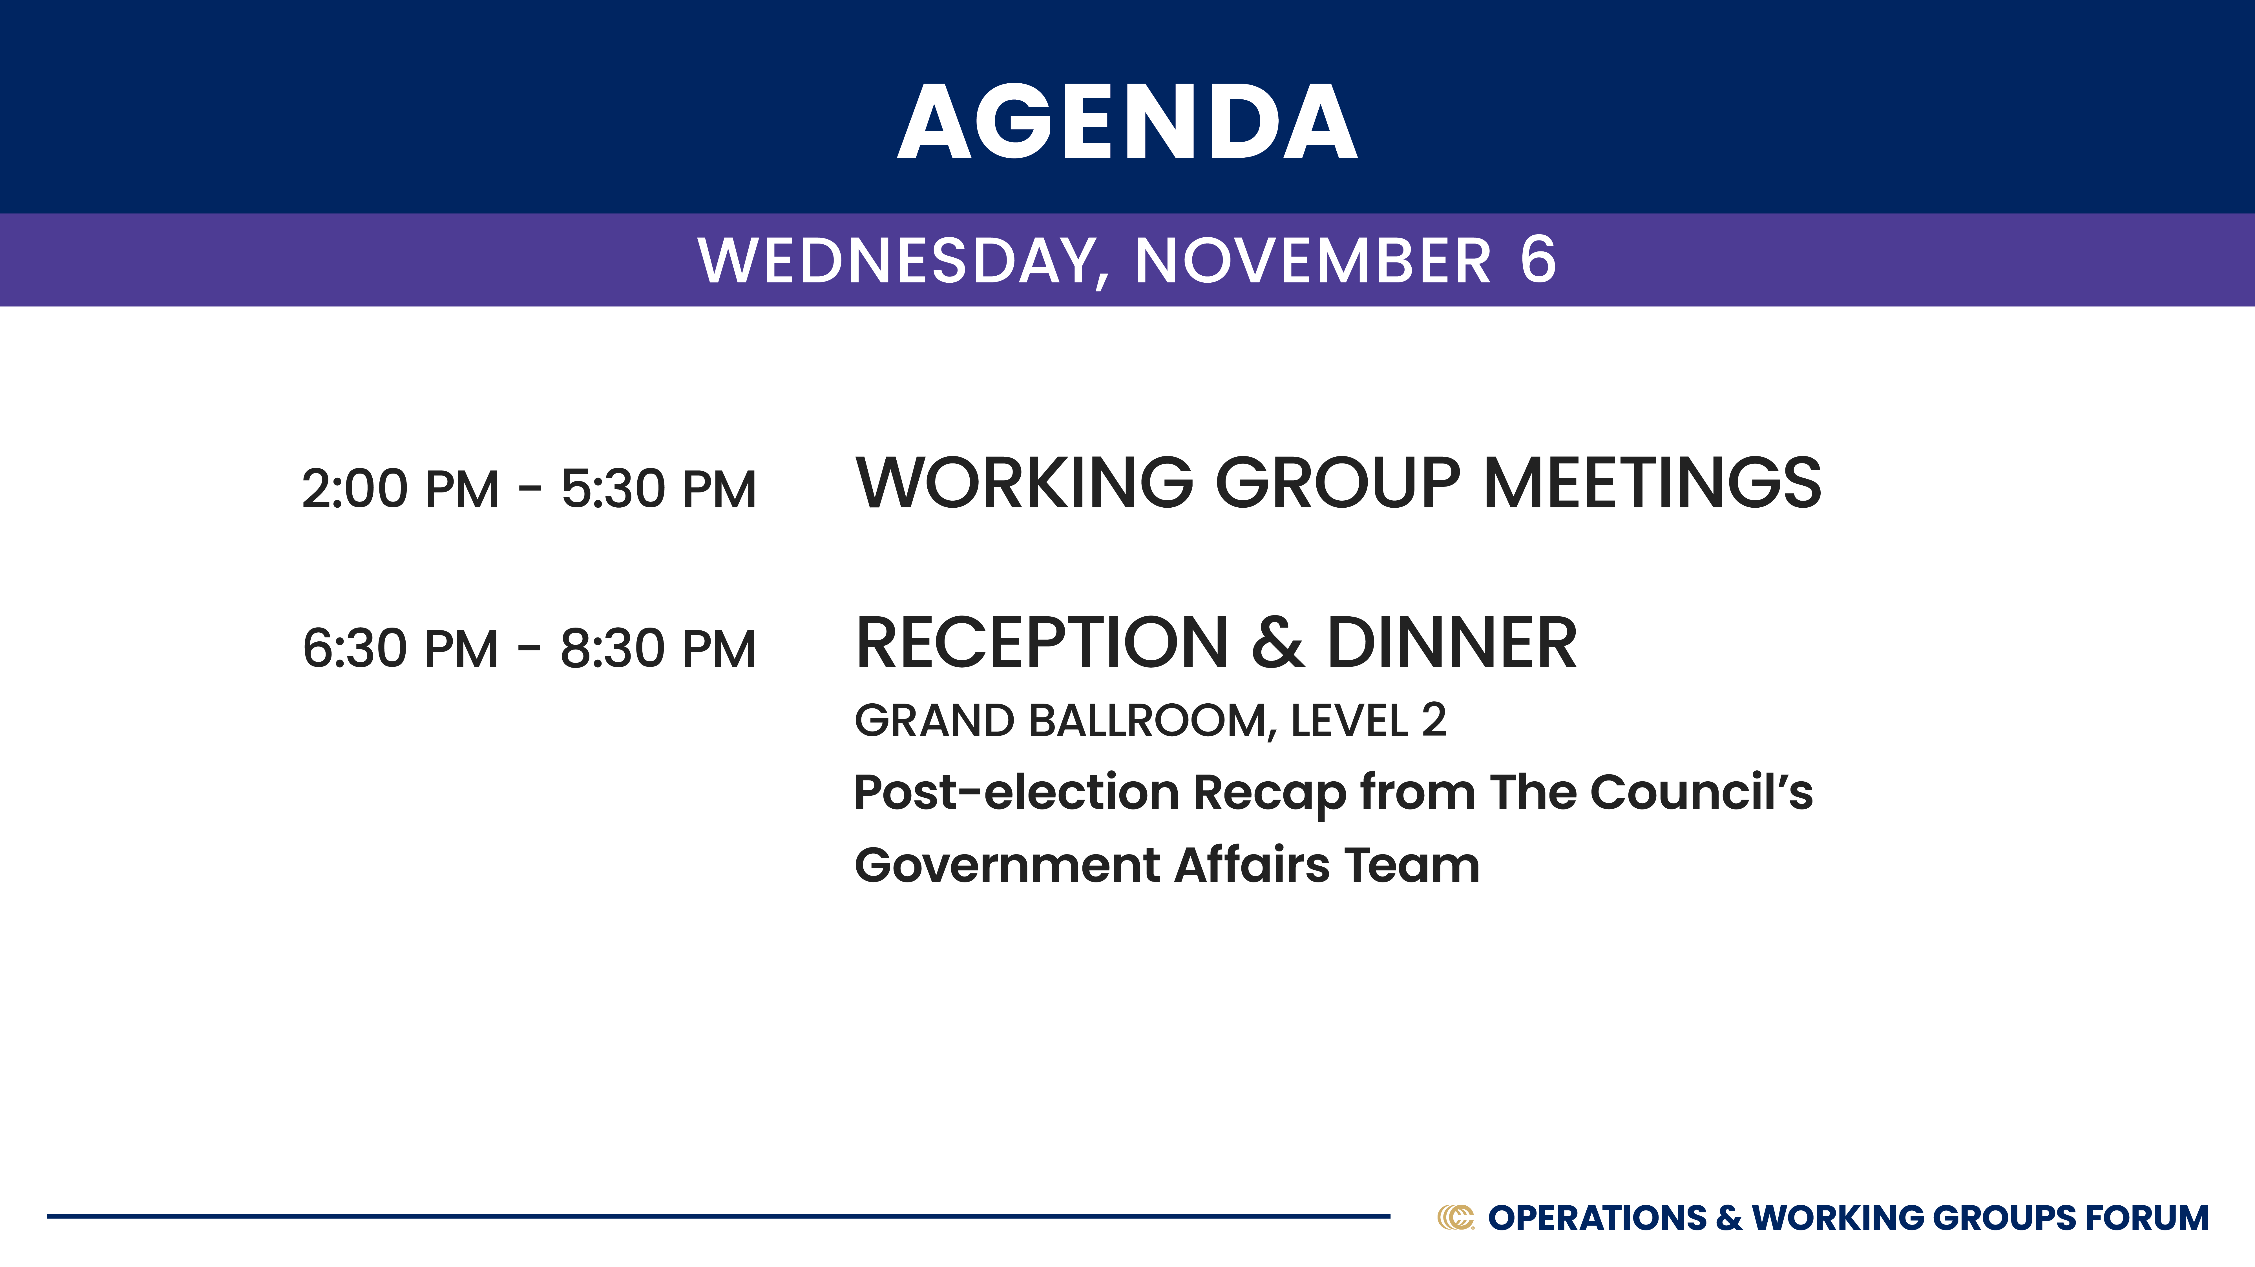

Slide 4
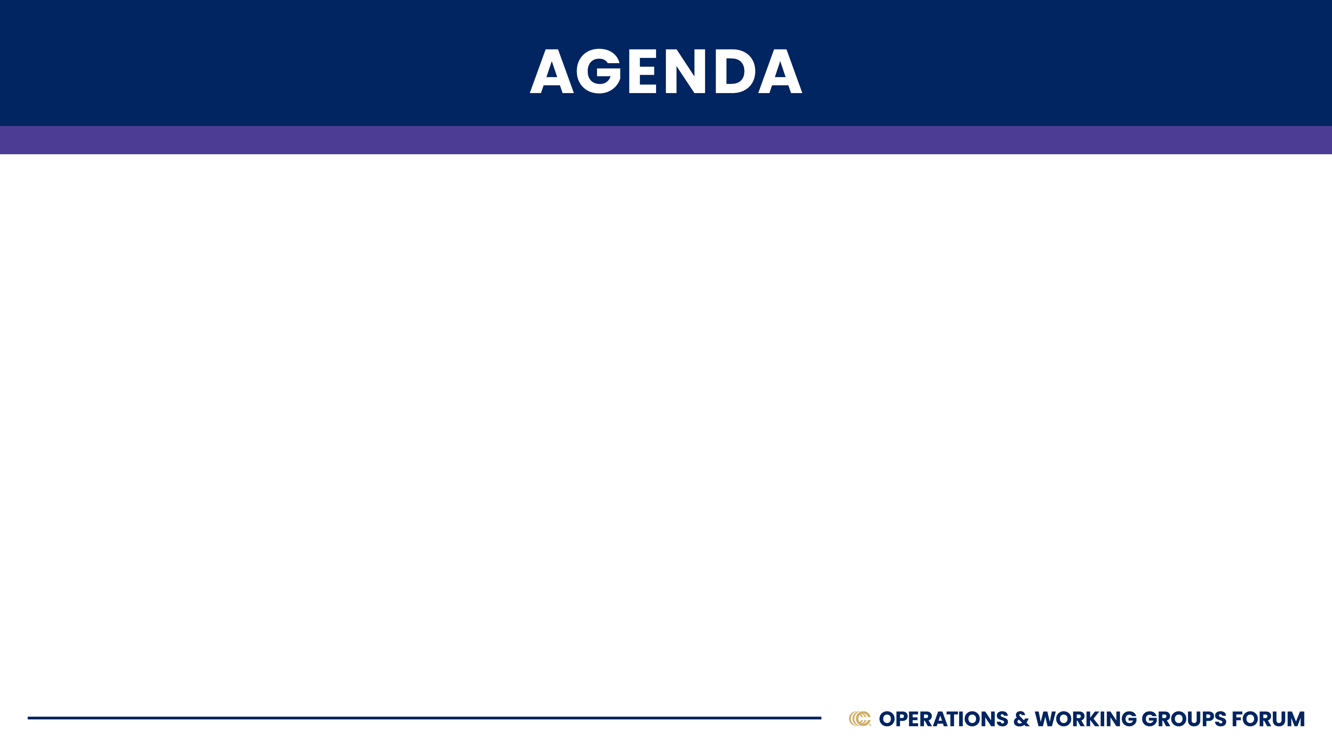
WEDNESDAY, NOVEMBER 6
Welcome & Introductions
Virtual Guest Speaker: Karen Horning – CEO, National Insurance Producer Registry (NIPR)
Break
Small Legal Department Operations
Overview of Operations Survey Results: Ken Haltenhof – VP of Membership, CIAB

Slide 5

Welcome & Introductions
Name
Title
Firm
Set up of Legal & Compliance Department
Question of the Day: You can only speak by quoting one movie. What movie would you choose?

Slide 7
Small Department Legal Operations
Work flow processes, outsourcing, resource allocation, contract management
Where are you seeing success in developing new processes? OR where do you see success in what is already established?
What are your sticky points? Where do you hit brick walls?
Where have you spent the most money on resources?
What are you doing to make contract management more successful? More efficient?
Any vendor recommendations?
Identifying the focus of state Departments of Insurance
What is the most helpful: knowing active audits/investigations going in the states or knowing which laws have been passed?
Where is the concern?

Slide 8


Slide 9


Slide 10
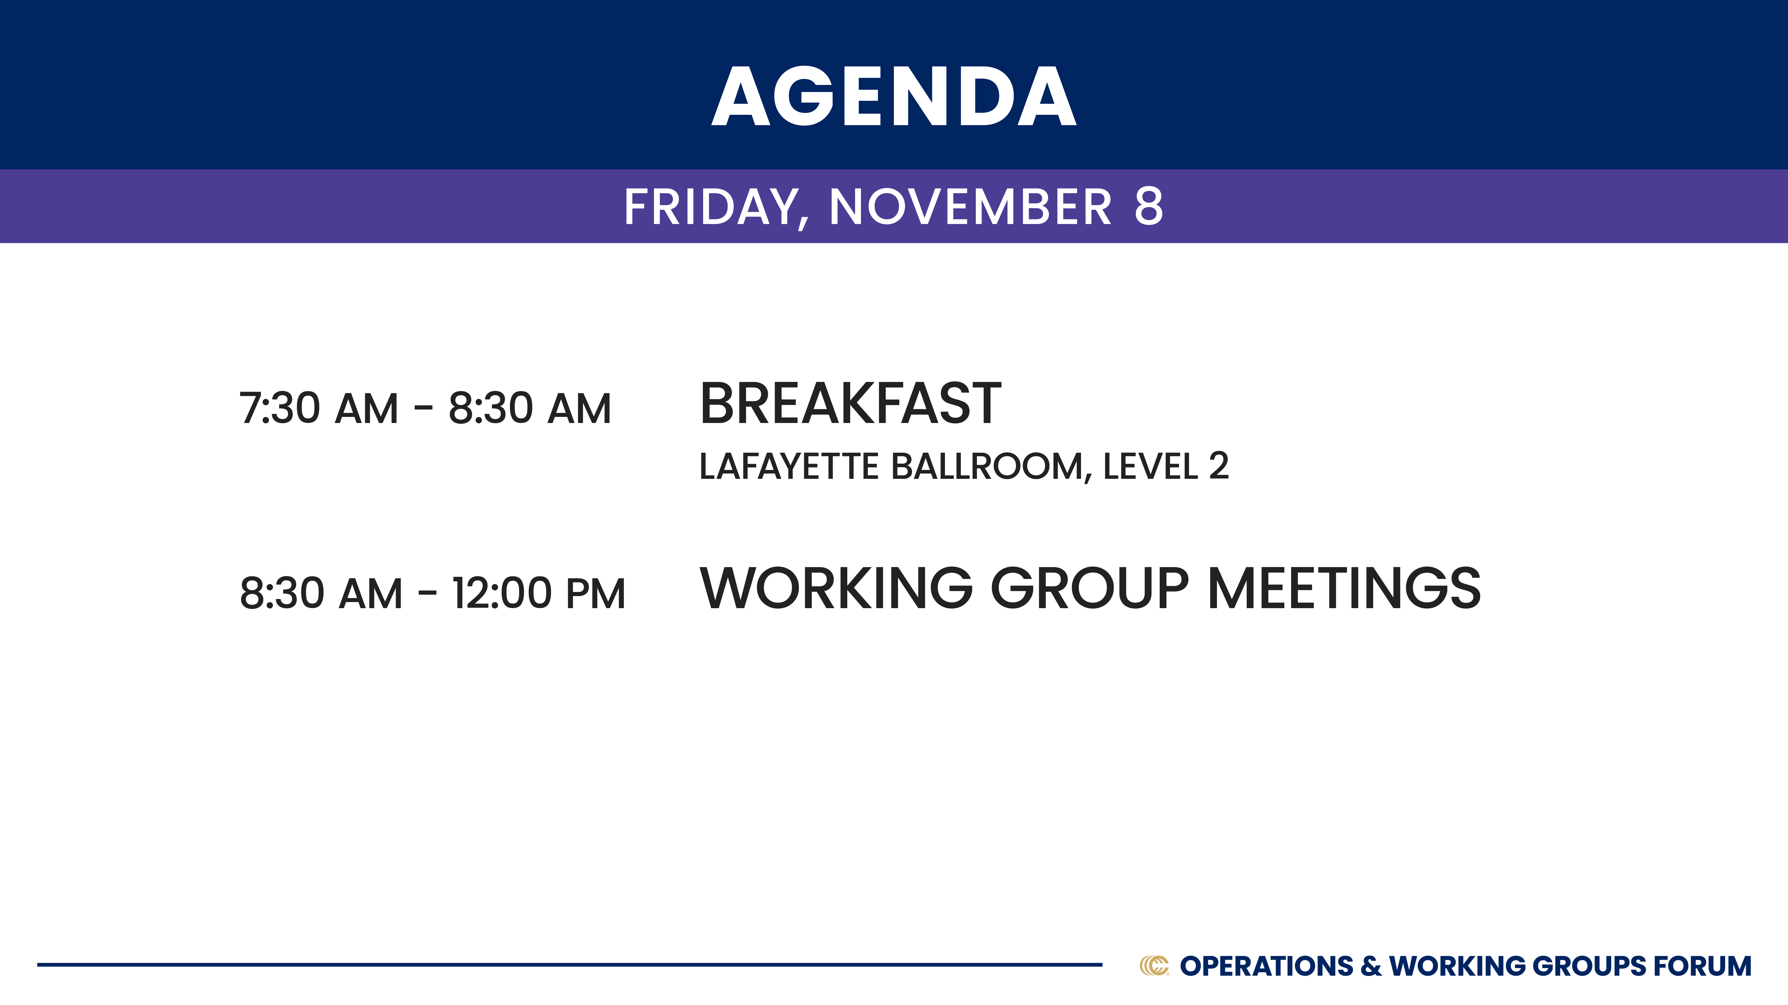

Slide 12

Legal Counsel and CFO
Joint Working Group Session
Discussion Overview
Tax Reform
Non-Compete and Non-solicitation Rule Updates
Cybersecurity Rules and Insurance Coverage Issues
Rebating and Value-Add Services
Premium Trust Rules
Licensing Uniformity
Surplus Lines Licensing and Taxes
Member Information Exchange
  Certificates of Insurance
  Other topics?

Slide 13
Tax Cuts and Jobs Act (TCJA) & 2025 Tax Reform Overview
TCJA – first significant rewrite of tax code since 1986
Changed many key individual, estate & corporate tax provisions
Enacted on a purely partisan basis
All individual & estate TCJA provisions sunset in 2025 (or before)
CBO: $4 trillion over 10 years to fully extend TCJA
Both parties planning significant 2025 TCJA-related legislation
  House & Senate Tax Writing Committees already at work on proposals
Election results could be outcome determinative
Everything will be on the table for reform in 2025

Slide 14

Candidate Provisions on Key TCJA Provisions
Issue | Current Law under TCJA | Vice President Harris | President Trump
Individual Rates | Reduced marginal tax rates across the board, Top marginal rate: > $731K: 37% (39.6% prior) | < $400K: Retain TCJA Rates; > $400K: 39.6% (pre-TCJA rate) | Make TCJA’s rates permanent
Corporate Rate | Permanently reduced the corporate rate from 35% to 21% | 28% | 20% (or 15%)
Estate Tax | Doubled the estate tax exemption from $5M to $10M > $10M: 40% | > $3.5M - < $13M: 55%, > $13M - < $93M: 60% > $93M: 65% > $1B: Additional 10% surtax | Make TCJA’s increased estate tax exemption permanent
SALT Deduction | The TCJA repealed or limited certain itemized deductions, including limiting the SALT deduction to $10K. | No position | Remove $10K Cap
Section 199A – Pass Through Deduction | To align with C-corp reduced rate, owners of S corps, LLCs and other PTs can deduct up to 20% of “qualified business income” | No position | Make Section 199A permanent
Section 163(j) – Business Interest Deduction | Limited the amount of net interest a business could deduct to 30% of adjusted taxable income (ATI). Until 2021: ATI = EBITDA From 2022 on: ATI = EBIT | No position | Make Section 163(j) permanent with the expanded definition of ATI

Slide 15
Vice President Harris Tax Policy Proposals
Individual Tax Provisions
Exempt tipped income from taxation (Trump)
Increase LT cap gains & qualified dividends tax from 20% to 28% if > $1M in taxable income
Increase net investment income tax from 3.8% to 5% if > $400K in taxable income
New first-time home buyer $25K credit
Make permanent the enhanced Child Tax Credit and increase the Child Tax Credit to $6K for newborns in their first year
Extend the enhanced ACA subsidies
Business Provisions
Increase corporate tax from 21% to 28%
Increase the corporate alternative minimum tax from 15% to 21%
Quadruple the stock buyback excise tax from 1% to 4%
Expand the deduction limit for startup business expenses from $5K to $50K
High Net Worth Provisions
Impose a new 25% minimum tax on total income, including unrealized capital gains, for all taxpayers with net wealth of greater than $100M.

Slide 16
Fiscal Outlook
Total Government Spending in 2023: $6.1 Trillion
Mandatory Spending: $3.8 T
  Social Security: $1.3 T
  Medicare: $839 B
  Medicaid: $616 B
Discretionary Spending: $1.7 T
  Defense: $805 B
  Non-Defense: $917 B
Net Interest: $659 B
Total Government Revenue in 2023: $4.4 Trillion
Individual Income Tax and Withholding: $3.8 T
Corporate Income Taxes: $420 B
Other Revenues (Federal Reserve earnings, excise taxes, customs fees, etc): $229 B
Budget Deficit in 2023: $1.7 Trillion
Current Federal Debt: $35.3 Trillion
Largest Tax Expenditures in 2023:
  ESI Exclusion: $237.4 B
  Pension/401(k)/IRA Exclusion: $185.1 B
  Long-Term Capital Gains Rate: $118.3 B
  Child Tax Credit: $67.5 B

Slide 17
10 Year Cost of Expanding Key Expiring Tax Provisions
Reduced Marginal Tax Rates | $2.15 Trillion
Limit on Itemized Deductions (including $10K SALT Deduction Limit) | [$1.86 Trillion]
Alternative Minimum Tax (AMT) Exemption and Phaseouts | $1.35 Trillion
Increased Standard Deduction | $1.25 Trillion
Increased Child Tax Credit | $747.7 Billion
Section 199A Deduction | $684.2 Billion
Expansion of ACA Premium Tax Credits | $383 Billion
Section 168(k) Expensing/Bonus Depreciation | $378.5 Billion

Slide 18
Non-Compete and Non-Solicitation Rules
Federal Activity
April 23, 2024 - Federal Trade Commission finalized its noncompete rule.
  Retained ambiguous language on non-solicitation agreements
  Adopted the Council’s recommendation to exempt non-compete agreements in owner business sales
August 20, 2024 – Federal court struck down the rule (Ryan LLC v. FTC, No. 3:24-CV-00986-E, N.D. Tex. 2024)
  FTC is expected to appeal the decision to the Fifth Circuit
State Activity
4 states ban use of non-competes entirely (CA, MN, ND, OK); 33 others + D.C. restrict their use in some capacity (industry, wage, etc.)
States that proposed complete (or near-complete) bans, but failed:
    Illinois (HB5385)
    Kentucky (HB772)
    New York (engrossed) (S6748)
    Rhode Island (vetoed) (S2436)
    Virginia (SB360)

Slide 19
Cybersecurity
New York cyber regime is the national baseline
  Risk Assessments and independent audits
  Access and privilege management
  Breach notification and incident response plan
  Certification of compliance by Chief Information Security Officer
Cyber insurance issues
  Push for “rating without filing” approach (IL, NJ, TX)
  Clarity around permissible value-add services
Discussion
Other issues or pain points?
Resource Note:
See Steptoe’s comprehensive summary of New York’s Final Regulation.

Slide 20
Rebating
Recent state activity
  North Carolina (SB 24, enacted June 20, 2024) permits offering of products or services that do not exceed $250 if they are offered in connection with marketing/retention, are related to the insurance, or provide risk control and meet additional conditions.
  Pennsylvania (SB 1092, enacted July 8, 2024) aligns state requirements with the NAIC Model; increased the amount of permissible non-cash gifts from $100 to $125.
Discussion
  Revised NAIC UTPA Model – issues or challenges related to value-add services?
  Other member pain points?
Premium Trust Rules
Resource Note:
See Steptoe’s 50-state surveys on Surplus Lines and Premium Trust Rules
No recent state activity
Discussion
  Member pain points?

Slide 21
Producer Licensing Uniformity
Federal
Resurrecting the National Association of Registered Agents and Brokers (NARAB)
  CIAB partnering with WSIA and the Big I
  Strategy to amend the Board appointment process
State
NIPR education campaign
Possible joint trades effort through the NAIC’s Producer Licensing Task Force
  Return to the Uniform Licensing Application
  Appointments reform (who and when)
  Business entity affiliations
  Surplus lines licensing
Discussion – Member observations, other issues or pain points?

Slide 22
Surplus Lines
Licensing
NC update
Signal of activity in other states: AL, IL, LA, ME, ND, NH, NM, TN
Different state statutory triggers for SL licensure:
  “Sell, Solicit, Negotiate” (see e.g., New Jersey, New York)
  “Procure” (see e.g., Illinois, Connecticut, Virginia)
  “Place” (see e.g., California, Florida)
  “Transact” (see e.g., Pennsylvania)
  Other (see e.g., Texas, Massachusetts)
NAIC Model: A person shall not procure a contract of surplus lines insurance with a nonadmitted insurer unless the person possesses a current surplus lines insurance license issued by the commissioner.
Discussion
Other pain points or states top of mind?
Resource Note:
NEW Steptoe
50-state survey on surplus lines licensing – COMING SOON!

Slide 23
Surplus Lines - continued
Premium tax payments
NIMA and SLIMPACT allocation models failed
Most states now collect 100% of premium if they are home state of the insured
Resource: 2024 manual maintained by Locke Lord at surplusmanual.locklord.com
Discussion
Other pain points or states top of mind

Slide 24
Joint Member Information Exchange
Certificates of Insurance
Other topics?

Slide 25
NAIC/NCOIL Update
Privacy Working Group
Other Topics of Interest

Slide 26
Health & Benefits
Mental Health Parity – Final Rules
HIPPAA – Reproductive Health
Transparency
  Gag Clause Attestation
  Air Ambulance Reporting – No Final Rules
  ERISA Fiduciary Duty
2025 FSA Limits
New Guidance on 213(d) expenses & preventative care
ACA Updates
Samaritan Fund and other high-cost claimant vendor solutions
Colorado PBM reform law opt-in for self insured plans

Slide 27
Additional Member Items
Certificate of Insurance
Any other items for discussion

Slide 28
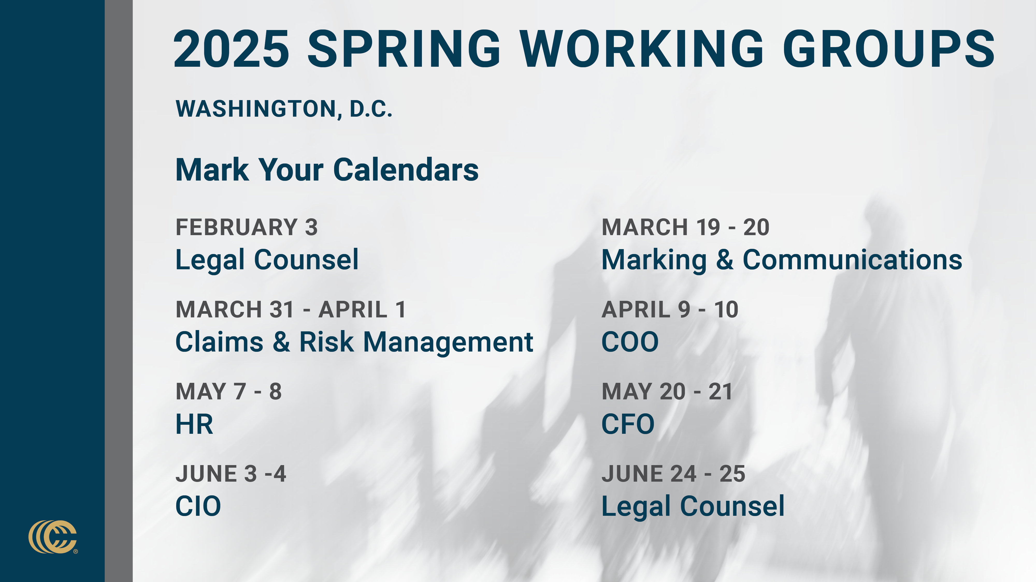

Slide 29
